Slide 1
Sentiment Analysis of
Prabowo-Gibran's Presidential Candidacy
Divergent Perspectives from Twitter and Online News Portals in Indonesia
PREPARED BY : ACHMAD DHANI & FARIS ARIEF M.

Slide 2



contents
Project Background
Problem Statement
Methods
Twitter Sentiment Analysis
Media Sentiment Analysis
Conclusions

Slide 3


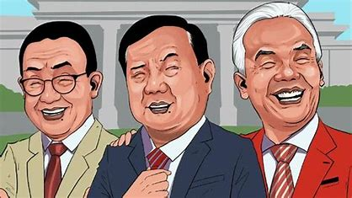



Project Background
Source : https://www.grahanusantara.co.id/
Source : https://www.cnbcindonesia.com/
Notes:
As Indonesia approaches its 2024 presidential elections, the political scene is dominated by three main candidate pairs: Anies-Muhaimin, Prabowo-Gibran, and Ganjar-Mahfud.
And in the recent months these candidates have become focal points in public discourse, sparking widespread conversations across social media platforms and online news portals.

Slide 4
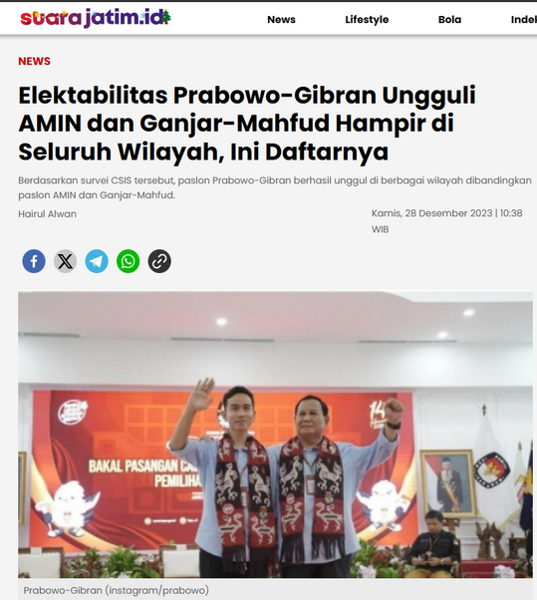





Project Goals
Source : https://jatim.suara.com/
An intensified discussions in both public and media domains
Prabowo-Gibran stands out with their high electability highlighted in CSIS surveys
Sentiment Analysis towards Prabowo-Gibran candidacy to provide a nuanced understanding of the electorate's perceptions of this leading pair.
Notes:
Among the 3 candidate pairs, Prabowo-Gibran is particularly notable, as underscored by their high electability in CSIS surveys. This has sparked intensified discussions in both public and media domains, driving our project's focus towards sentiment analysis, especially on Twitter (X') and online news portals.
Our project aims to comprehensively analyze public sentiment and reactions towards the Prabowo-Gibran candidacy. By leveraging the immediacy informations of Twitter and the comprehensive analysis available through online news portals, we intend to provide a nuanced understanding of the electorate's perceptions of this leading pair. This approach will enable us to capture the essence of the nation's political pulse as we approach the elections.

Slide 5
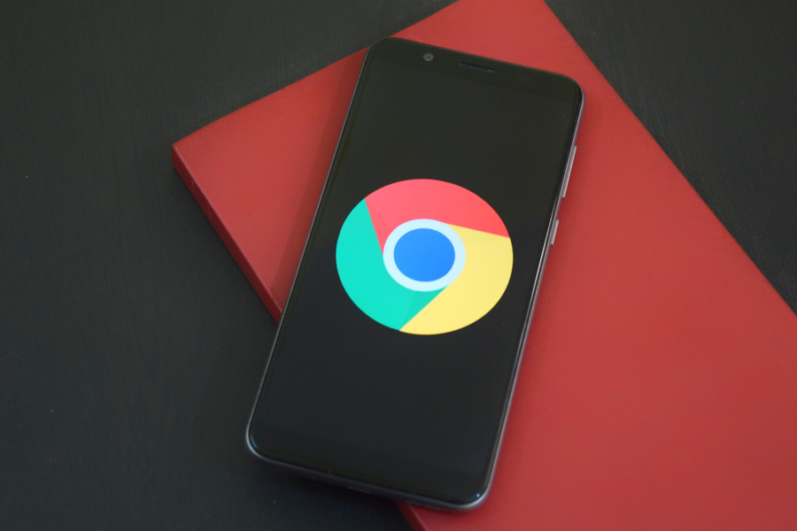
Workflow
Data Collection
2. Data Preprocessing
Collecting News/Articles and Several informations
a. Texts Preprocessing -> Processing and removing redundants words, symbols, and slangs
b. Sentiments Analysis
Publish Date
Source
Title
News URL
3. Exploratory Data Analysis
Collecting Tweets and Several informations
Exploring trends, tendencies, and patterns in the data.
Publish Date
Username
Tweets and Hashtags
Tweets Engagement Rate
Twets URL
Followers Count
4. Data Visualizations
Translating complex data into visual formats like charts, graphs, and maps, making it easier to understand and interpret

Slide 6

Results!

Slide 7
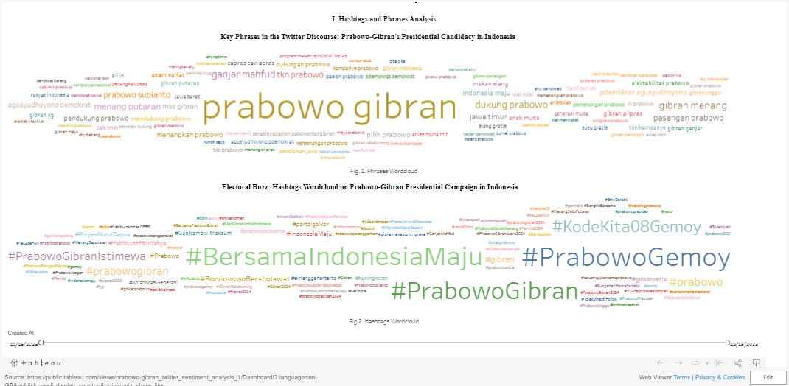
Twitter Keywords Analysis

Slide 8
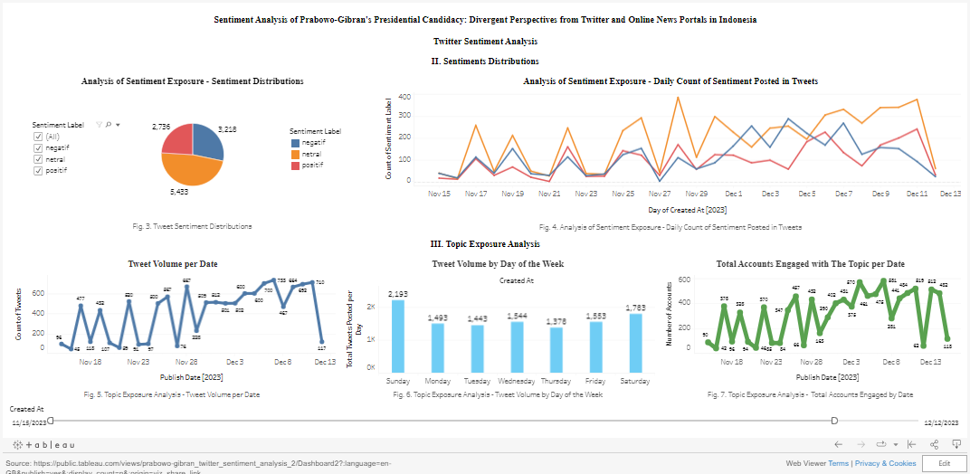
Twitter Topic and Sentiment Exposure Analysis

Slide 9
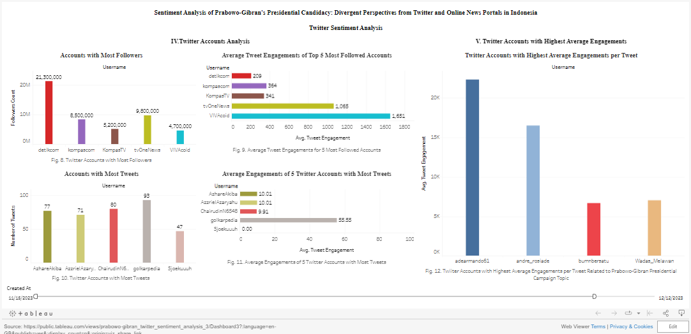
Twitter Accounts Analysis

Slide 10
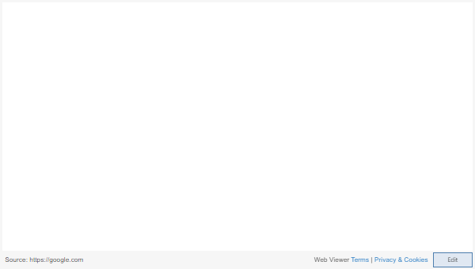
Accounts with most tweets by sentiments category

Slide 11
Conclusions
Twitter Sentiment Analysis Conclusions:
Main Discussion Themes and Focus: The most frequently used hashtags and phrases indicate discussions on Prabowo-Gibran primarily revolve around support for their victory or progress, religious or spiritual affiliations, and connections with specific political parties.
Variation in Sentiment Levels: The data reveals a dominant presence of neutral sentiments within the discussions, overshadowing both positive and negative sentiments. While there is a noteworthy variation ranging from positive to negative, it's the neutral sentiments that predominantly characterize the discourse. Additionally, certain accounts have been identified as significant contributors to each sentiment category, further diversifying the range of opinions expressed.
Fluctuations in Tweeting Activity: Daily tweet patterns show significant fluctuations, with sharp increases and decreases on different days, suggesting certain events or topics gain temporary focus.
Daily and Weekly Activity Patterns: Tweeting tends to increase and peaked on weekends, with lower activity at the start of the workweek.
Variations in Account Participation: The number of accounts participating in these discussions also varies significantly day-to-day, with periods of both high and low engagement.
Impact of High-Follower Accounts: Accounts with a high number of followers (Verified Accounts) tend to receive higher engagement compared to those with the most tweets.

Slide 12
Conclusions
Media Sentiment Analysis Conclusions:
Neutral Sentiments Dominate Media Coverage: The 'Neutral' sentiment is most prevalent in the dataset, with 1,925 news publications, indicating that the majority of news articles about Prabowo and Gibran's candidacy are neutral.
Significance of Several Media Platforms: Certain media portals, such as detikNews, Antaranews.com, Kompas.com, and Politik, have a higher number of publications compared to others.
Top Publishing Platforms by Sentiment:
Positive Sentiment: Includes Tribun Jabar, Tribunnews.com, and Rilis ID.
Neutral Sentiment: Led by Antaranews.com, detikNews, and KOMPAS.com.
Negative Sentiment: Includes Kilat, JPNN.com, and KOMPAS.tv.
Most Frequent Keywords: Phrases like 'prabowo', 'gibran', 'support', 'campaign', 'ganjar', 'presidential election', 'jokowi', and 'anies' are prominent, focusing on the candidates, their support, competitors, predecessors, and related campaign issues.

